Slide 1
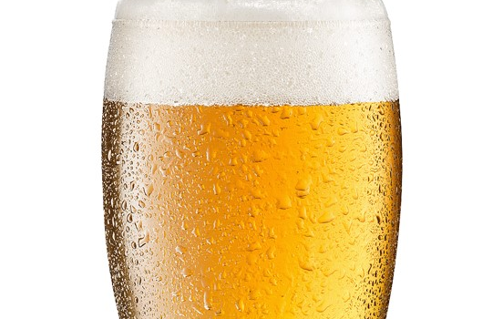
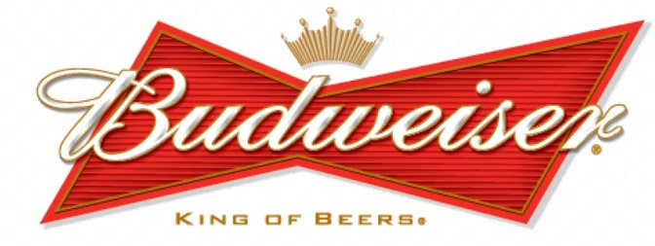
Statical Analysis Provided by
Always Analytics:
Nicole Assenza
Adam Vuinovic
April Erby

Slide 2
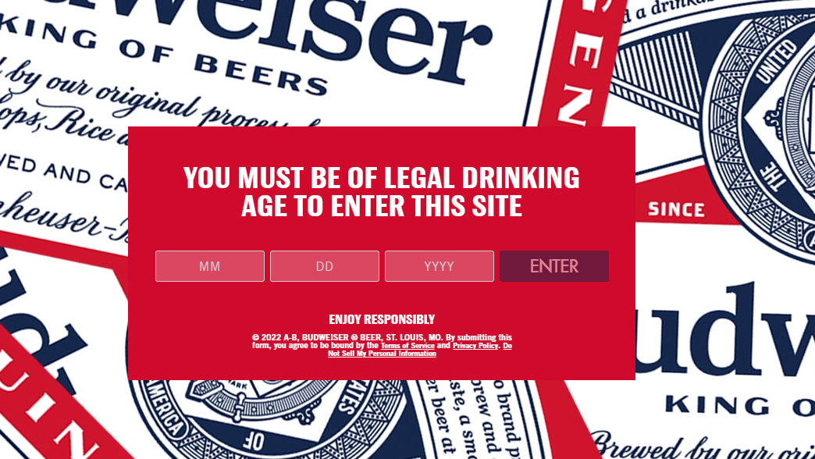
Exploratory Data Analysis

Slide 3
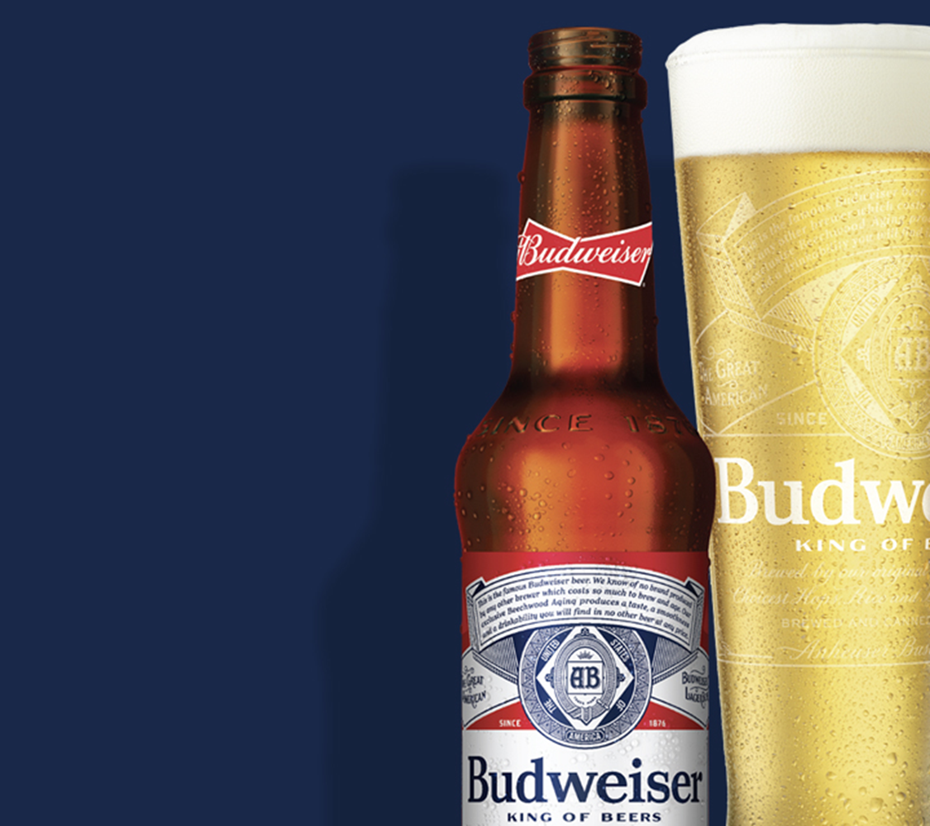
Introduction
Always Analytics was hired to investigate the data provided and gain insights into Budweiser’s questions of interest.
Initially, the data was split across 2 tables:
Beers contains a list of 2,410 U.S. craft beers with 7 variables:
Breweries consists of 558 U.S. breweries with 4 variables:
Data Description
Variable | Description | Type
Name | name of beer | character
Beer ID | unique identifier of the beer | integer
ABV | alcohol by volume of the beer | number
IBU | International Bitterness Units of the beer | integer
Brewery ID | brewery id associated with the beer | integer
Style | style of the beer | character
Ounces | ounces of beer | number
Variable | Description | Type
Brew ID | unique identifier of the brewery | Integer
Name | name of the brewery | character
City | city where the brewery is located | character
State | U.S. state where the brewery is located | character

Slide 4
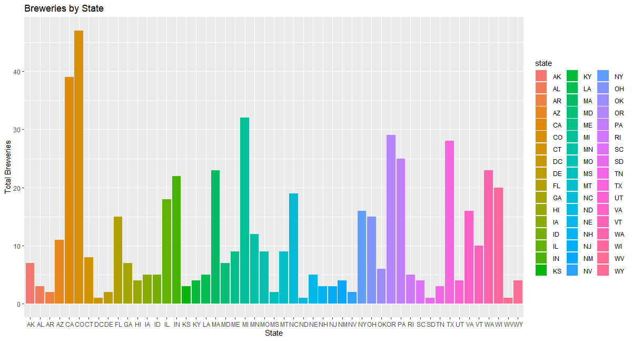
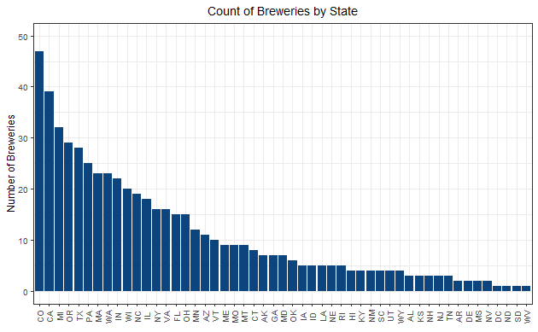
Question of Interest: How many breweries per state?
Top 5
Colorado | 47
California | 39
Michigan | 32
Oregon | 29
Texas | 28
Sorted alphabetically
Bottom 5
Mississippi | 2
North Dakota | 1
West Virginia | 1
South Dakota | 1
DC | 1
Sorted by volume

Slide 5
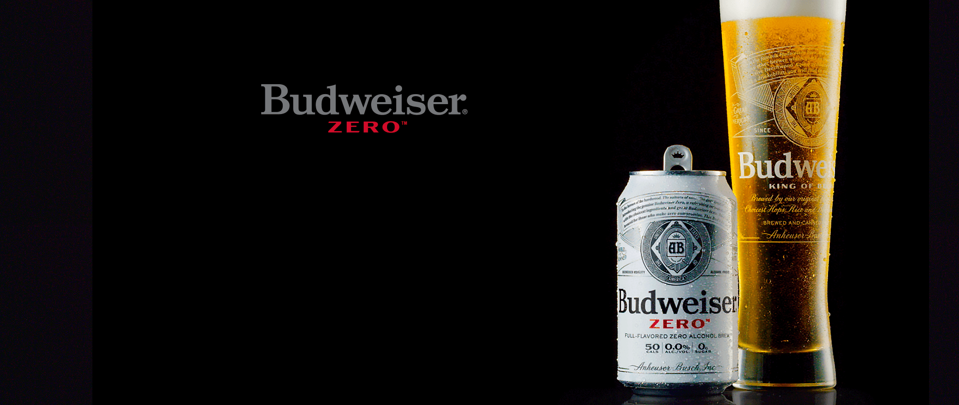
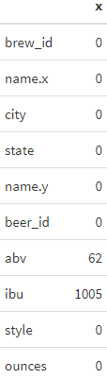
Question of Interest: How to address missing values?
Always Analytics identified 2 variables in the Beers data set that were missing information:
ABV was missing 62 observations
IBU was missing 1005
To account for the missing data, an imputation method was used, where the missing data was replaced with the mean as a substituted value.
Alternatively, the missing data could be excluded, however that would eliminate nearly half of the data (42%).

Slide 6

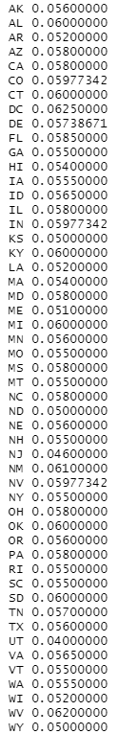
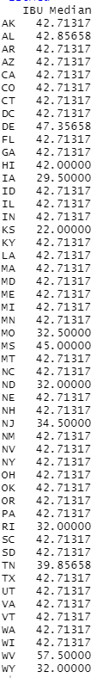
Question of Interest: What is the median ABV and IBU by state?
ABV by State
IBU by State
Notes:
Need to fix code for plot. Cannot pass this vector to ggplot. Tried setting as a df but only allowed to name the output median as a column. State has no header and could not set a 2nd variable name to df.

Slide 7
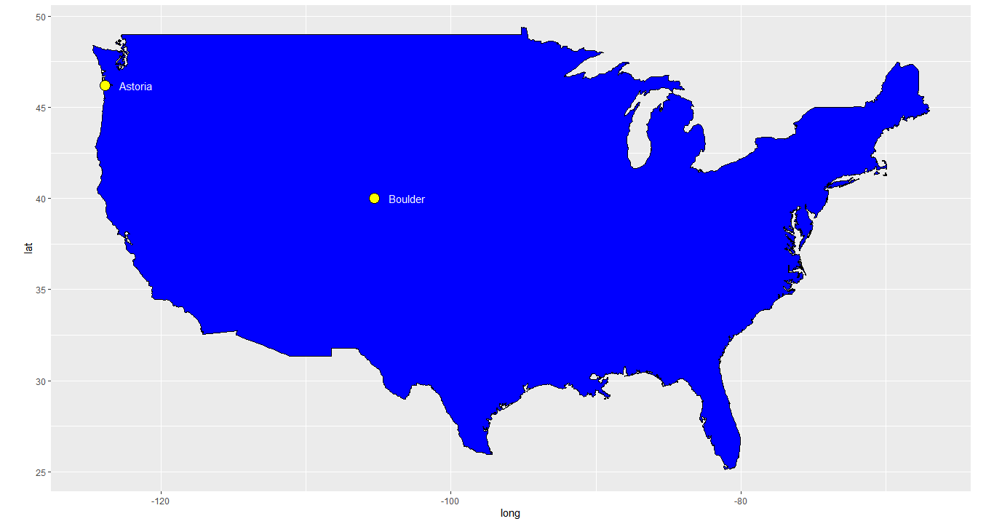
Question of Interest: Which state has the maximum ABV & IBU beer?
The max ABV beer is located in Boulder, Colorado
The max IBU beer is located in Astoria, Oregon

Slide 8
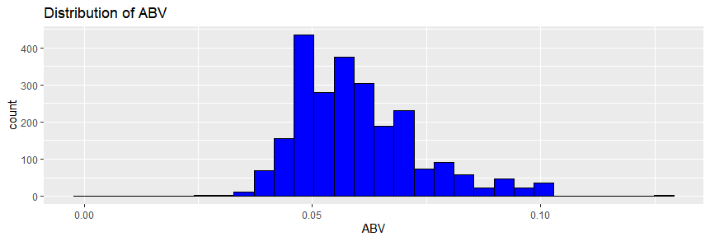
Question of Interest: ABV Summary statistics and distribution
The summary statistics for ABV indicate a tight interquartile range.
The range of this data set is between 1% and 12.8%.
In comparison, this aligns to the industry standard range where beers typically fall in the 3% to 13% ABV range.
As depicted by the distribution below, it appears normal with a slight right skew given the spread (i.e. max of 0.128 in Colorado).
Min | 0.001
Q1 | 0.050
Median | 0.057
Mean | 0.060
Q3 | 0.067
Max | 0.128

Slide 9
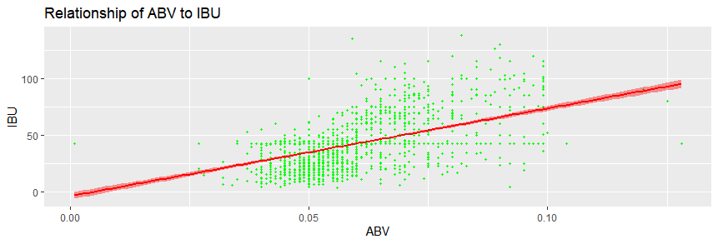
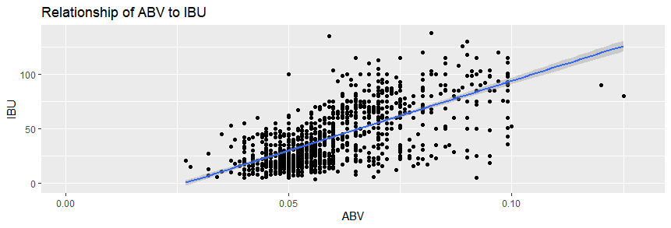
Question of Interest: Assess the relationship between IBU and ABV
The evidence suggests a positive linear relationship between bitterness (IBU) and ABV. A Pearson’s test indicates a moderate correlation of 52%
In conclusion, additional analysis is needed to determine if other variables are significant.
Always Analytics also examined the relationship between IBU and ABV for the data set missing values. Recall, in this case, the mean was not used to fill in the blanks.
Now, the correlation test yields a higher score of 67% which proves the impact of the missing data.

